Slide 1
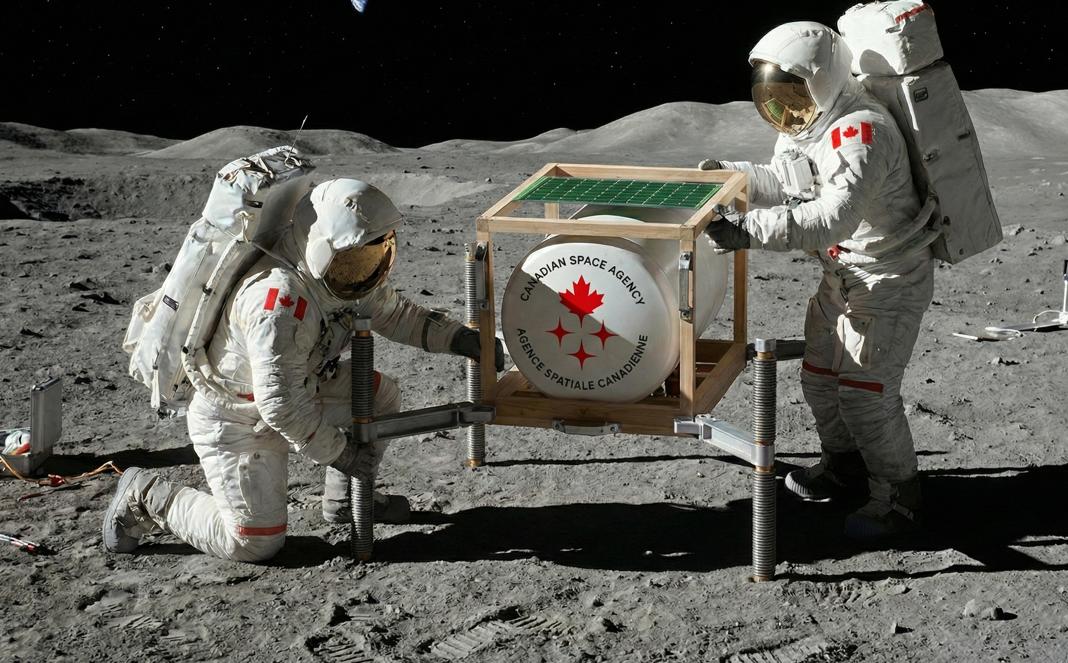

OASYS Leveling Mechanism
Engineering a stable foundation for lunar agriculture
Group 19

Slide 2

Mission Overview
The Challenge
The Client
Design a support structure to level the OASYS greenhouse prototype on uneven lunar terrain, enabling bio-regenerative life support system testing.
Canadian Space Agency (CSA) - advancing astro-horticulture through collaborative student innovation across Canada.

Slide 3
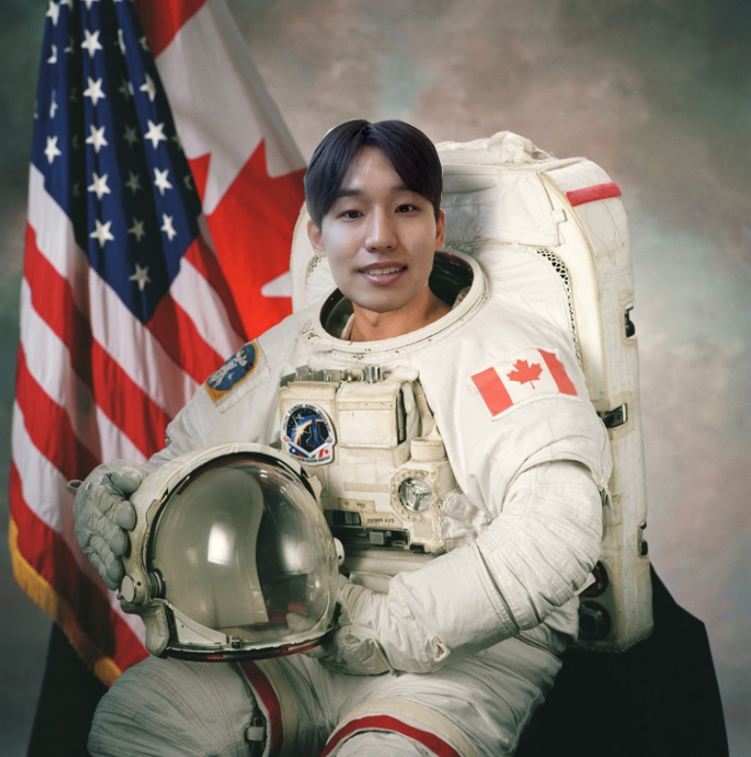
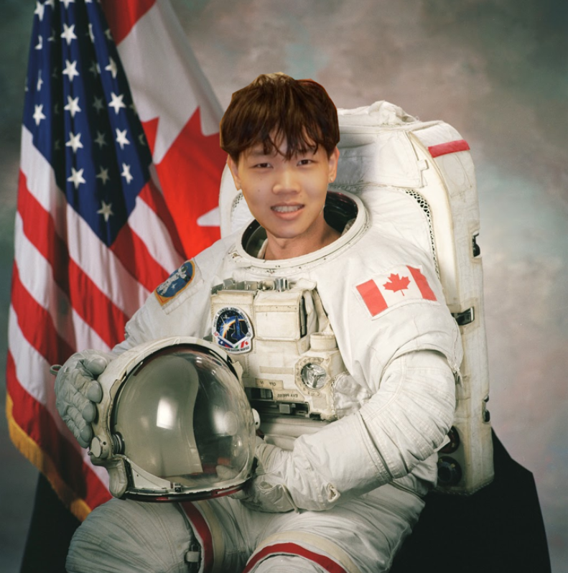
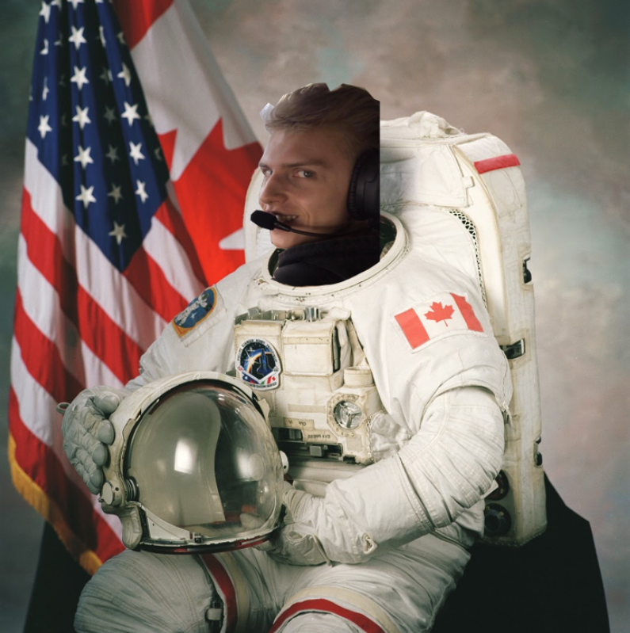

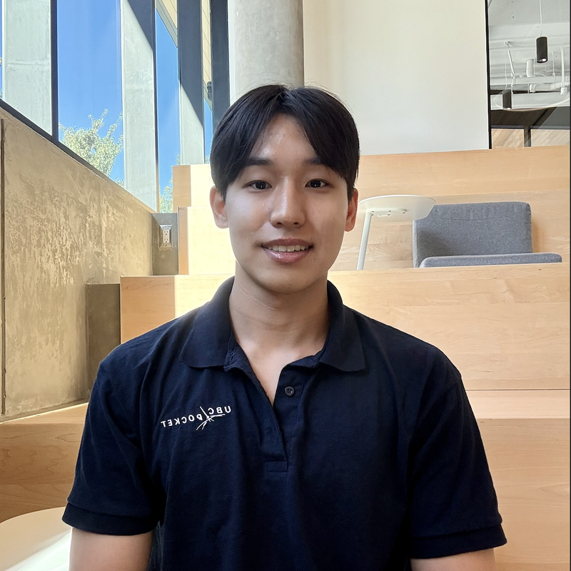

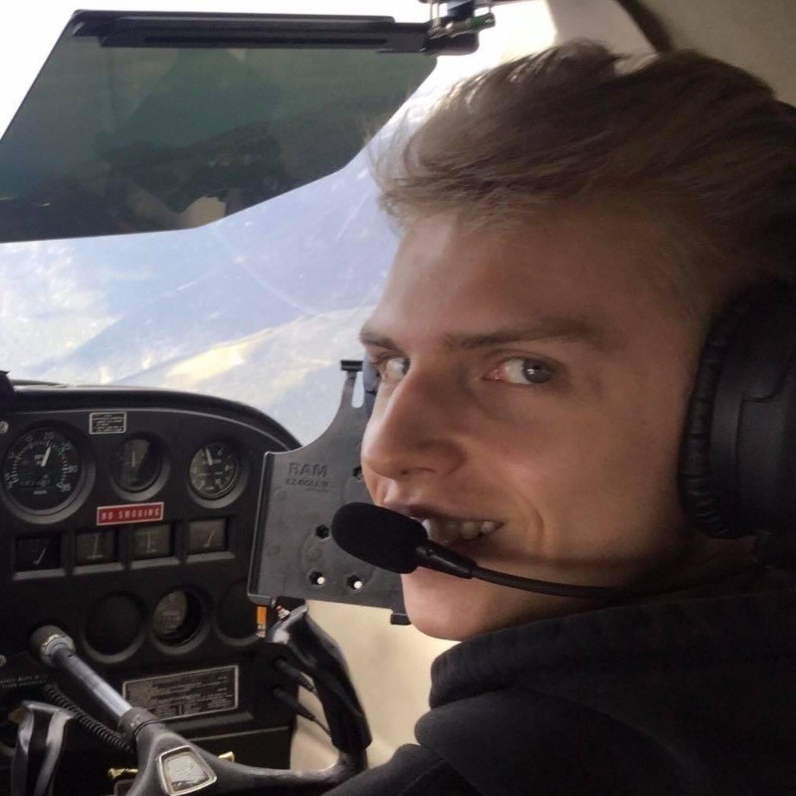

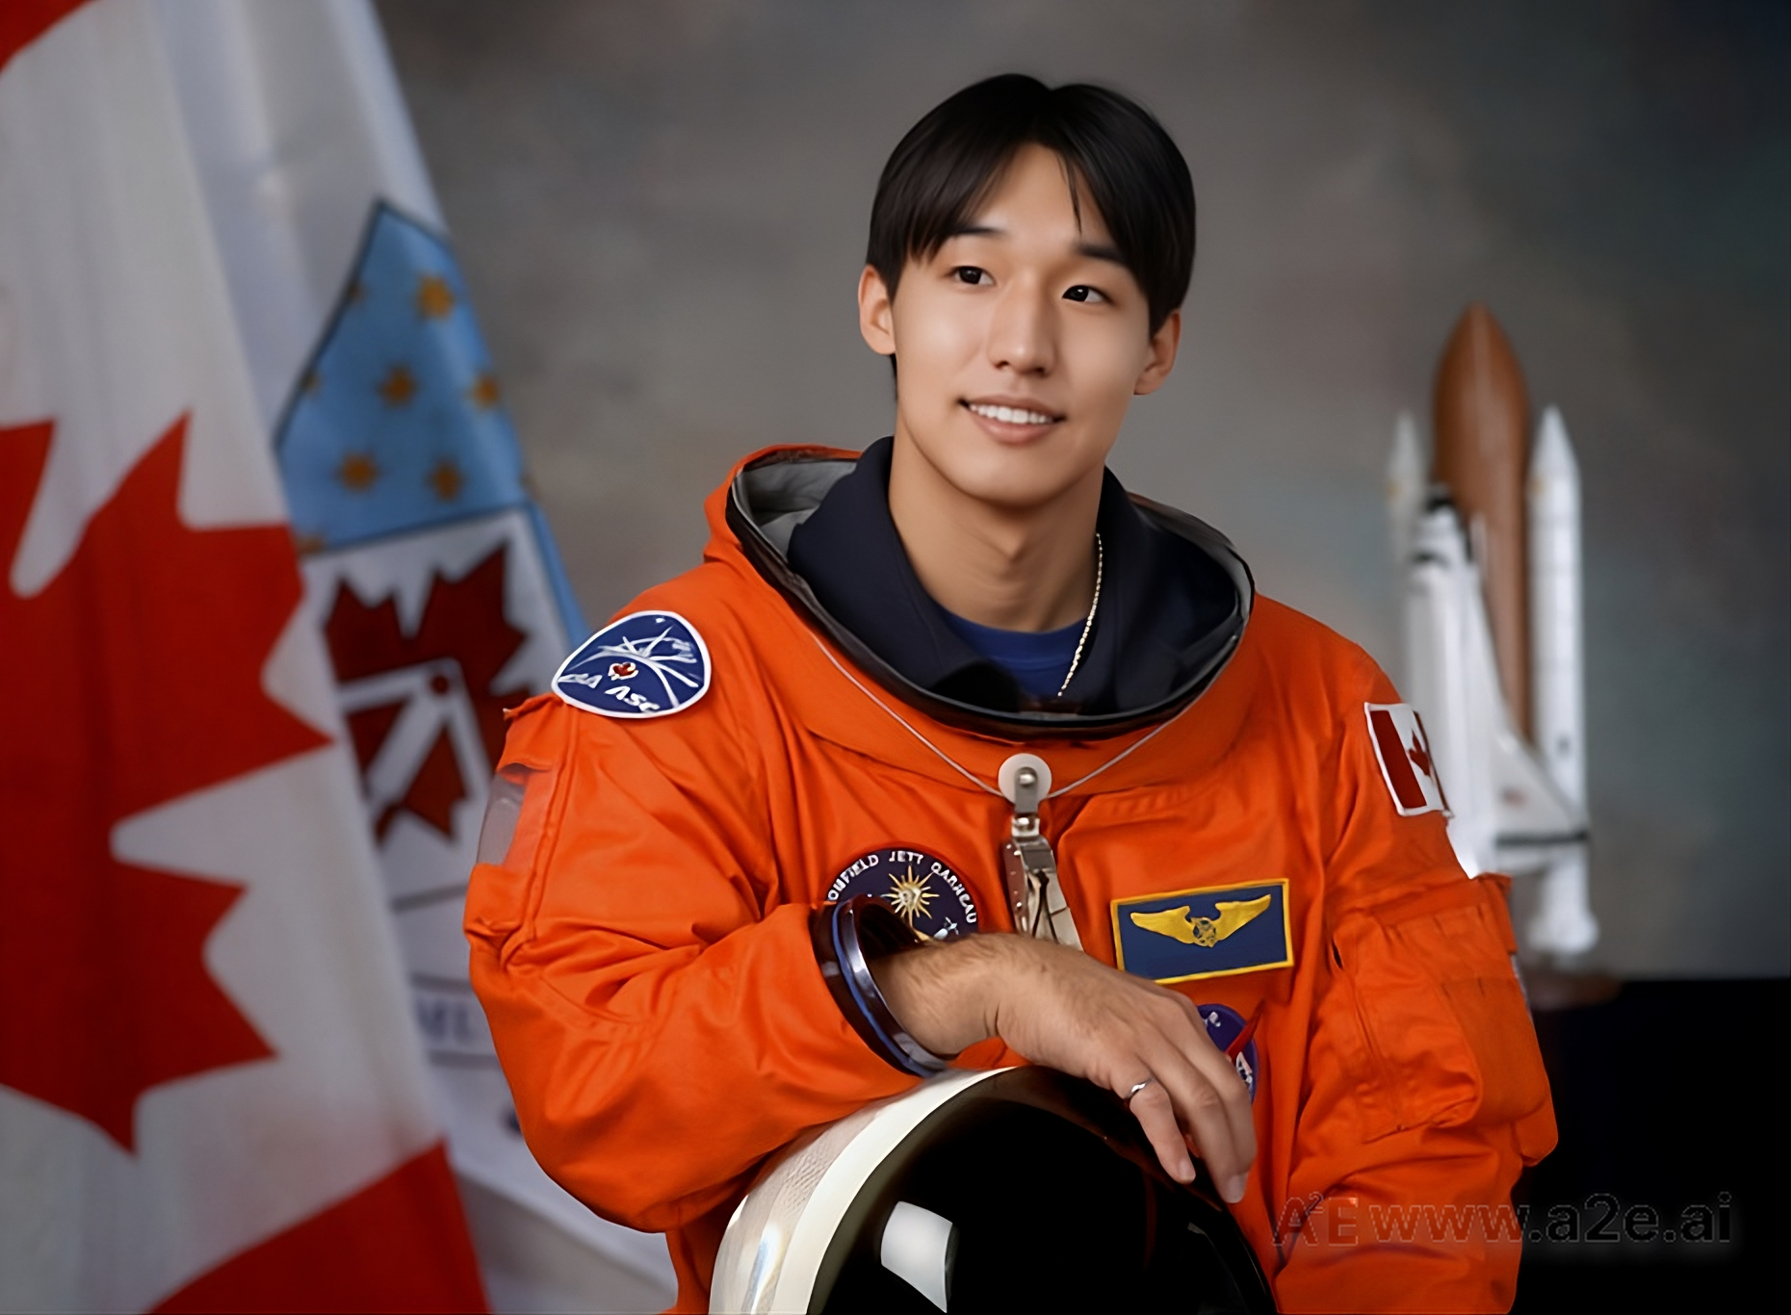
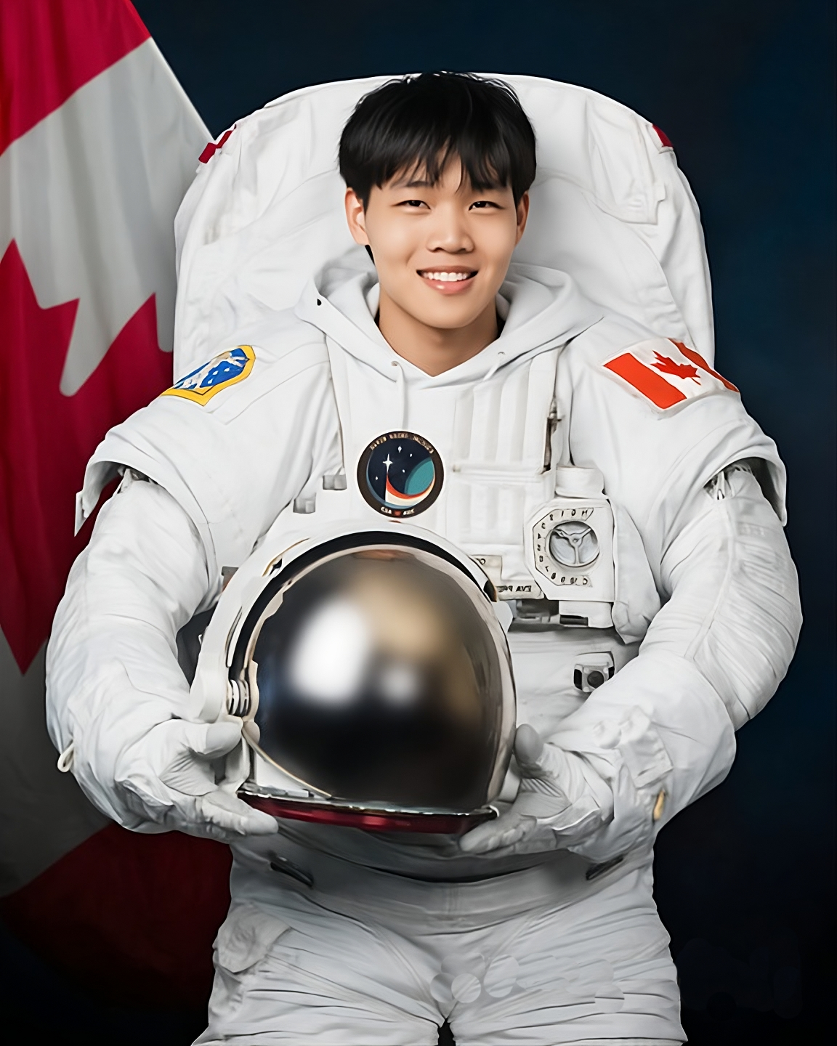
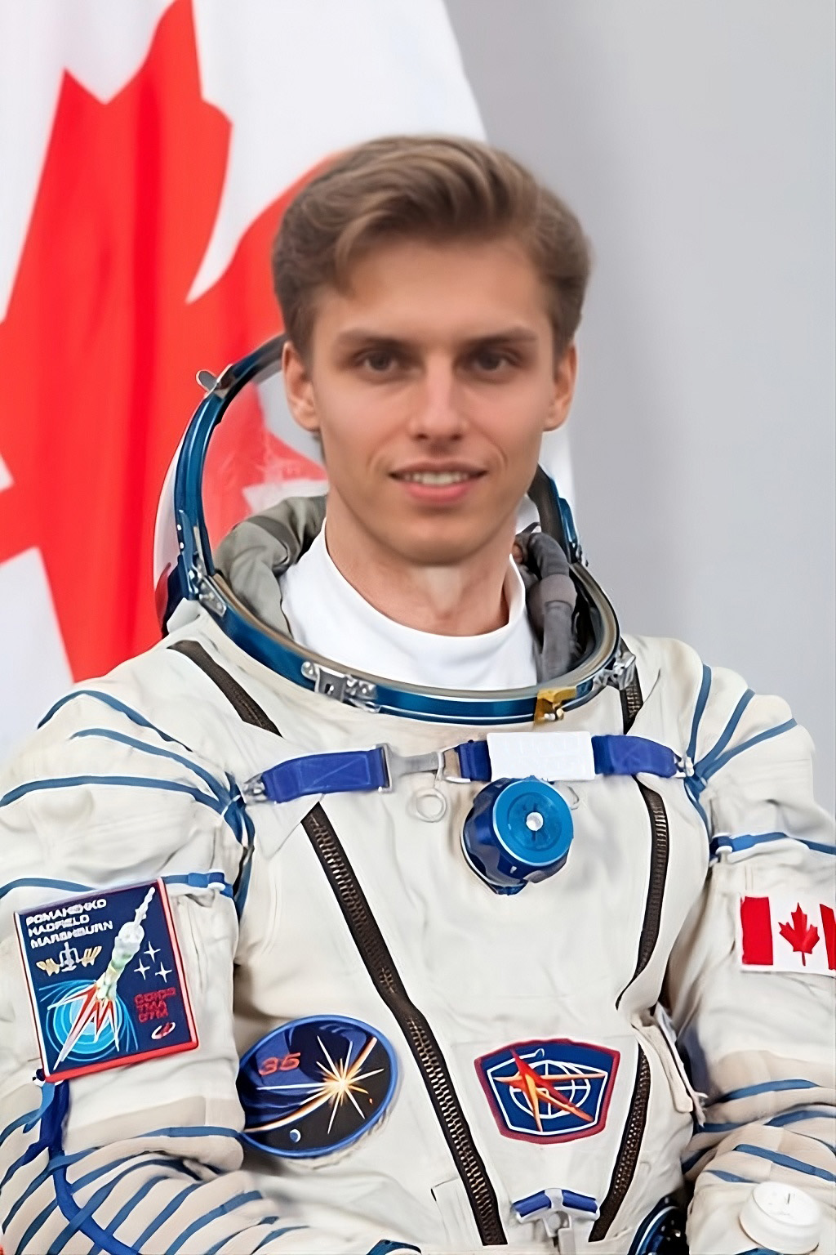

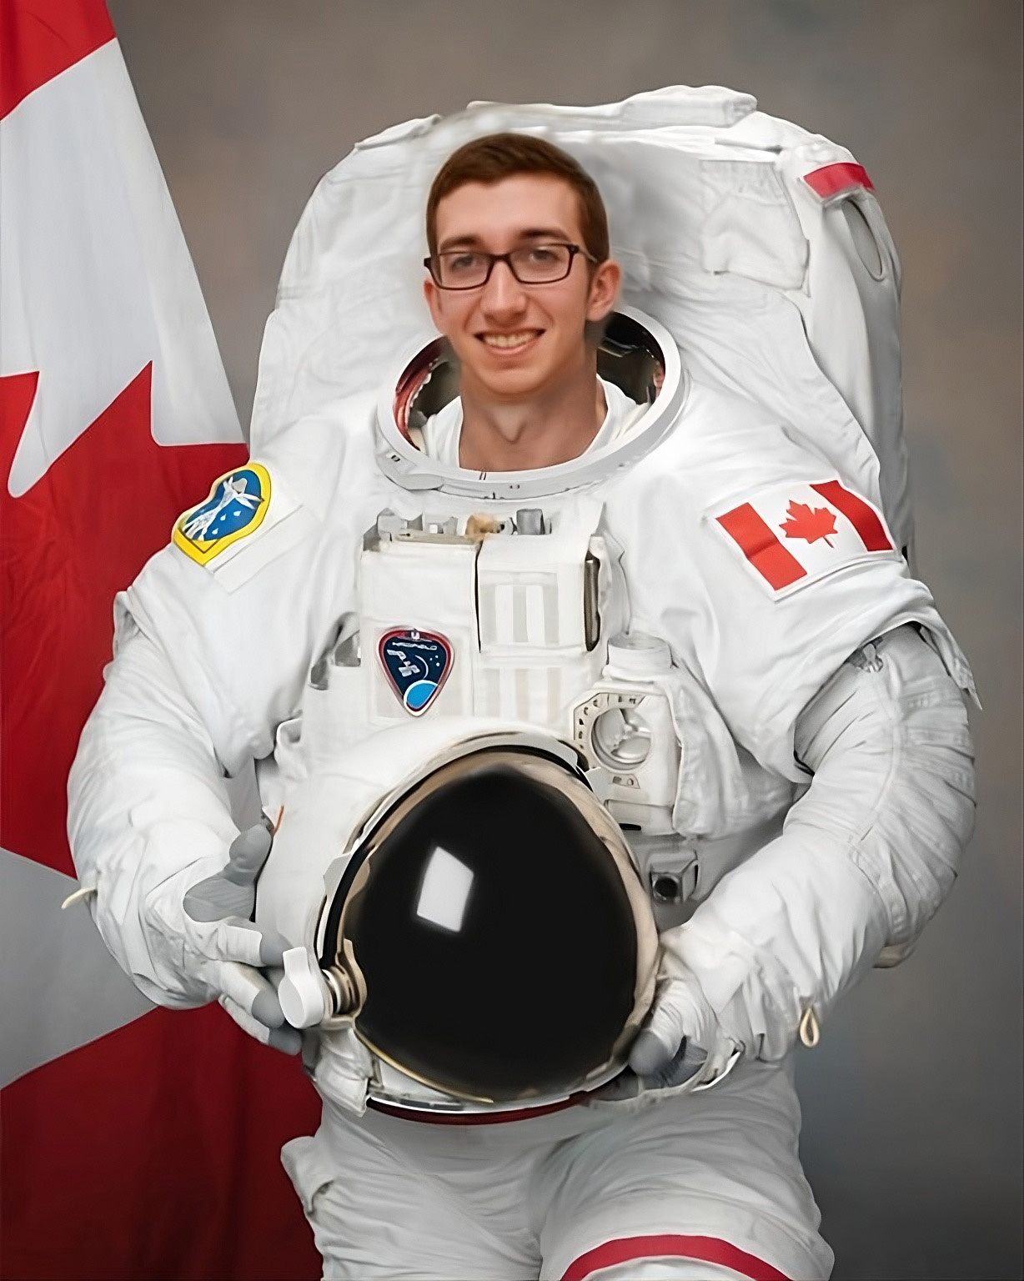
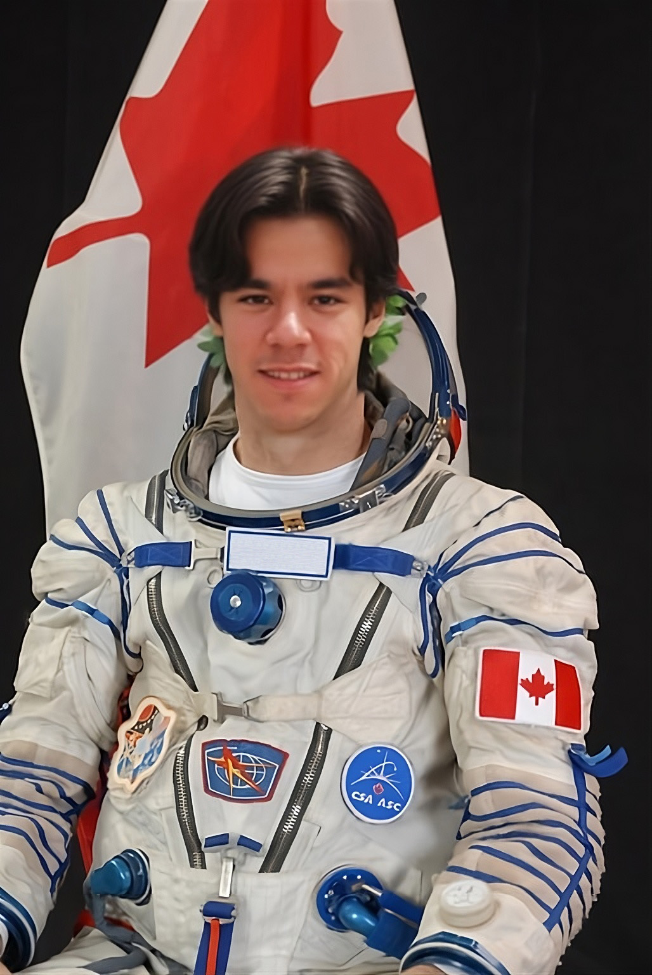
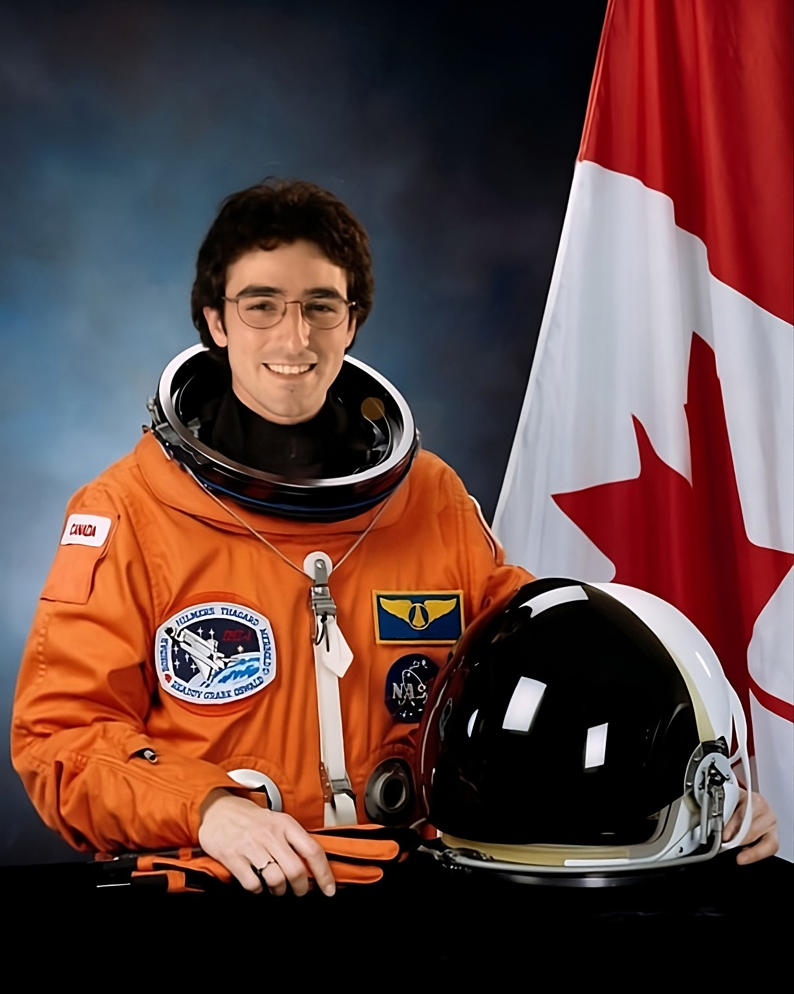
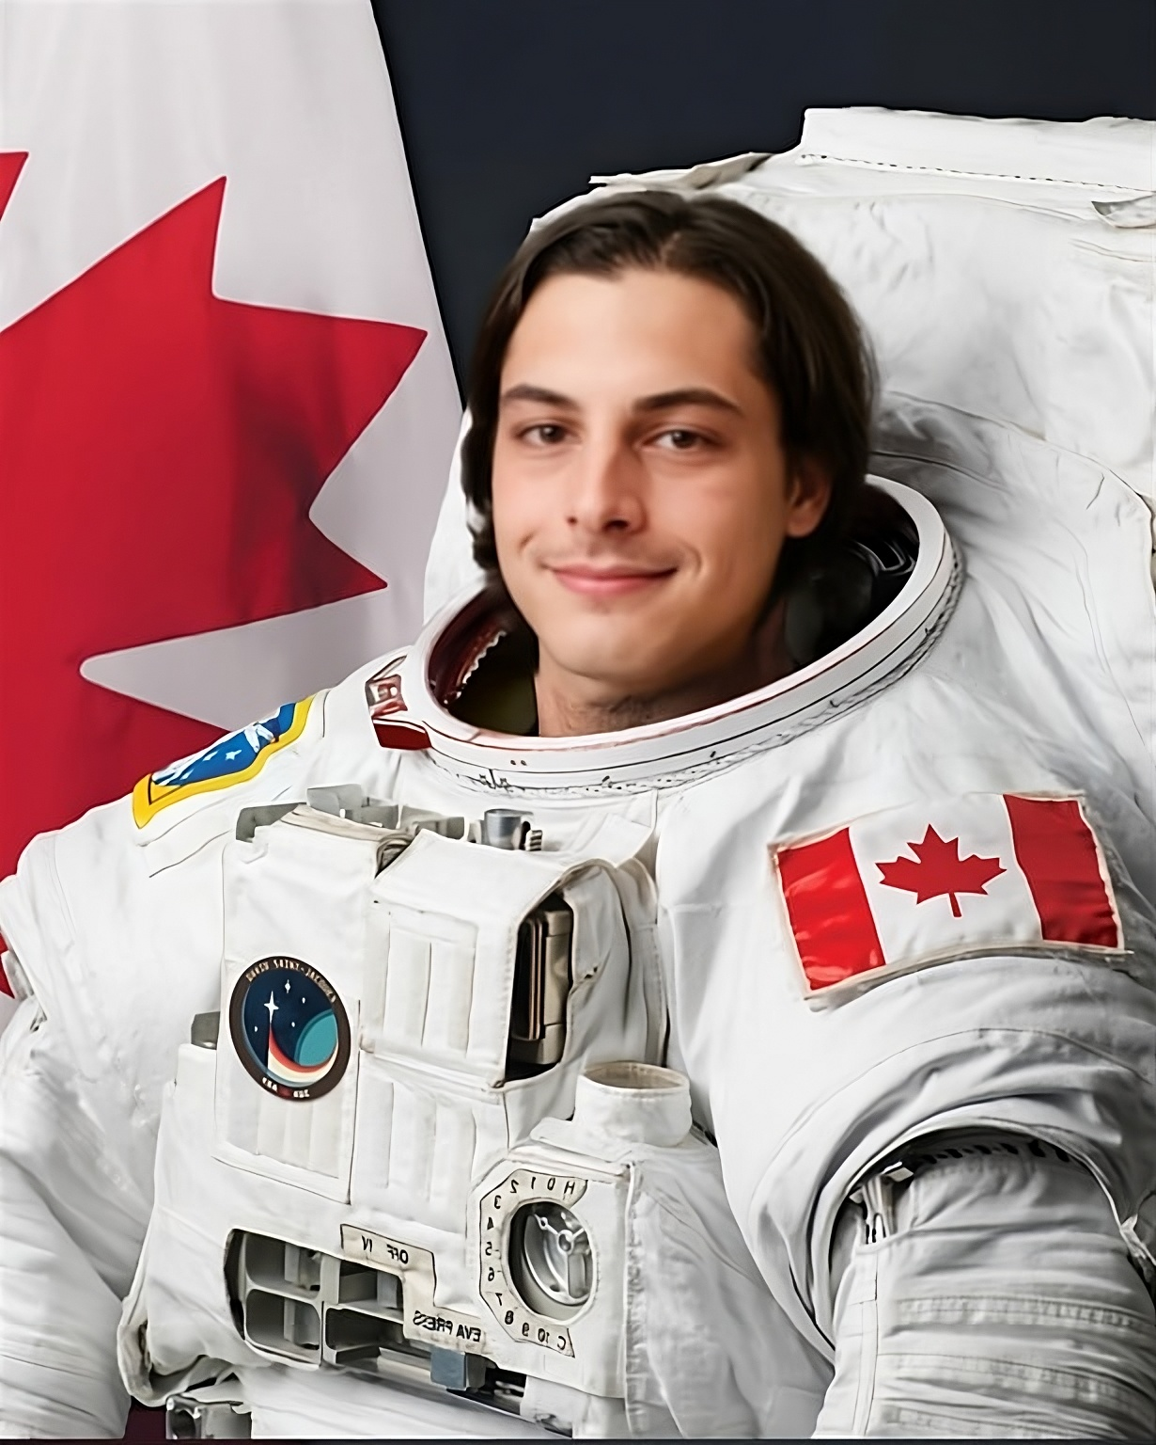
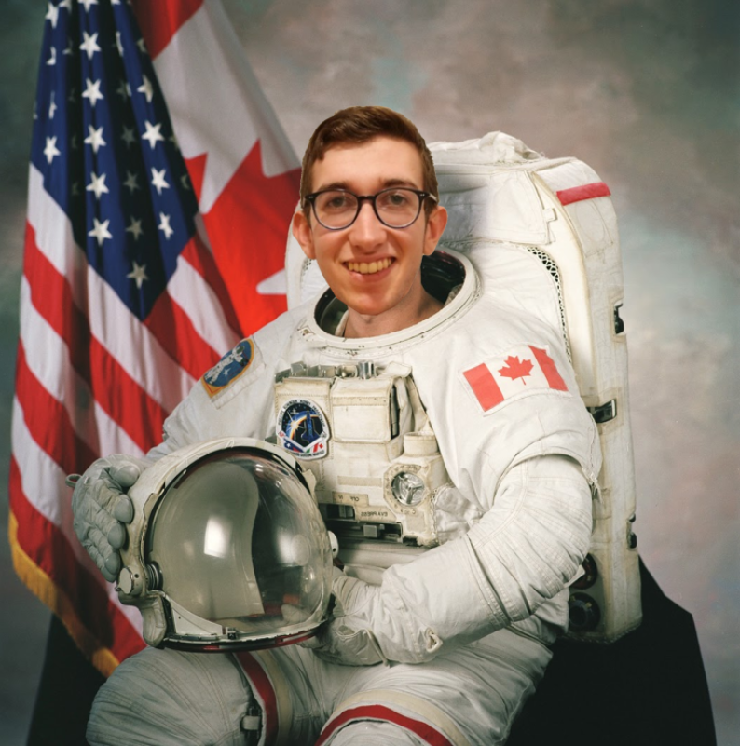

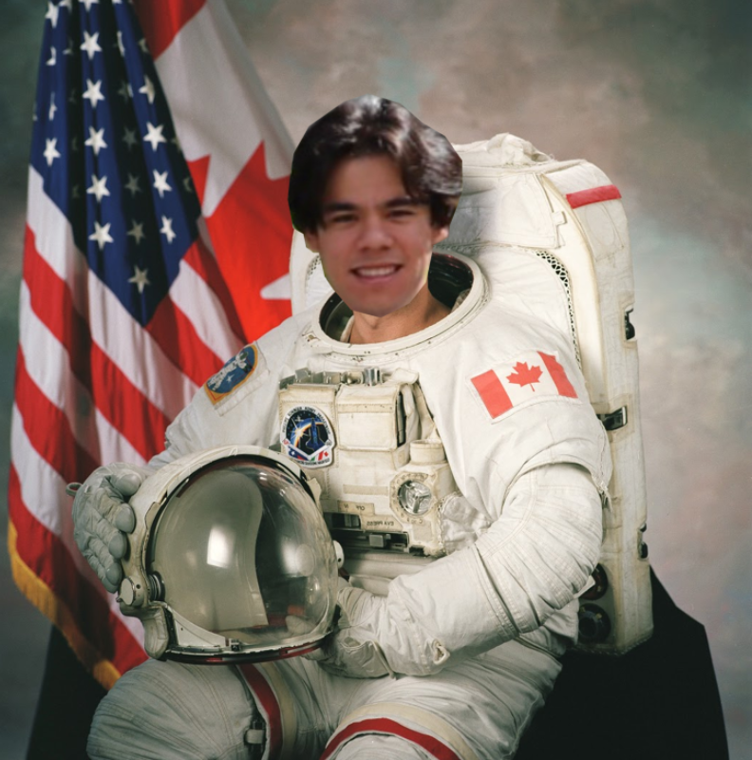
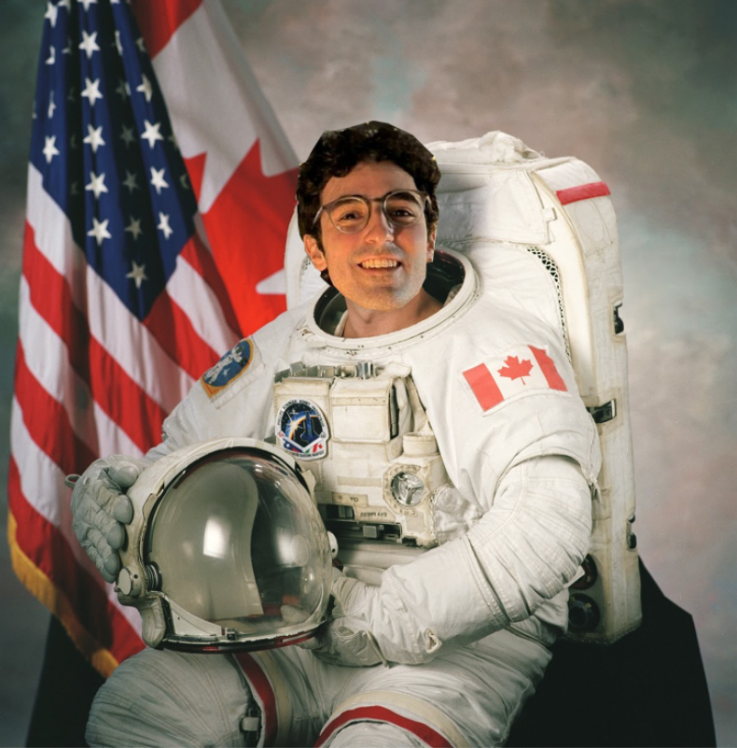
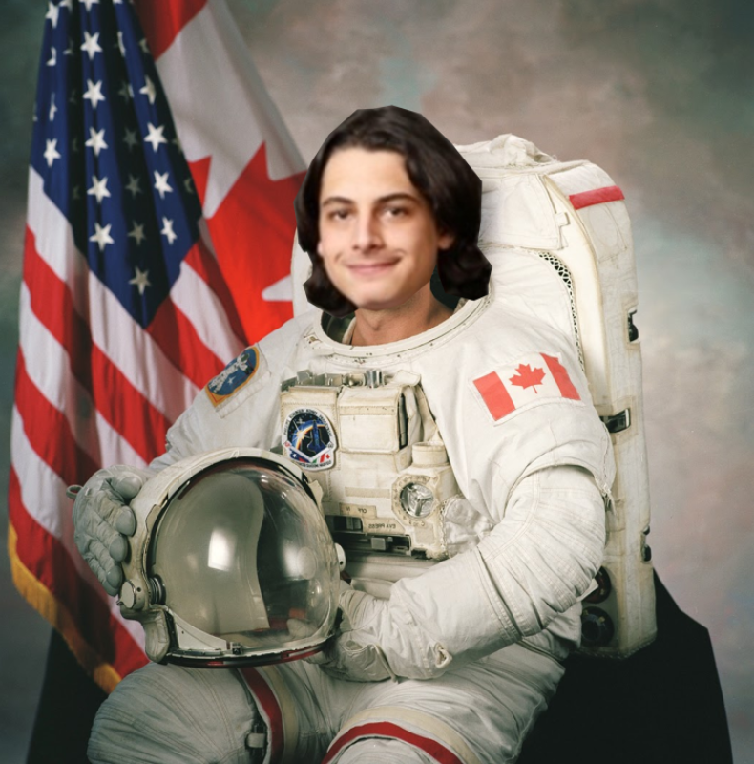



Meet the Team
Junheon "The Juggernaut" Kim
Stanley "The Rhino" Yang
Sasha "The Ace" Koochin
Jaden "The Cannon" Pereira
Danny “The Machine" Elizur
Colin "The Wildcard" Kitts
Igal "The Demon" Avimelek
Ronny "The Whiz" Cravioto-Ross

Slide 4

Our Mentor
Egor Yaritsa
Engineer – Engineering Development & Capability Demonstration Program
Canadian Space Agency (CSA)

Slide 5
Critical Requirements
Terrain Compensation
Ground Clearance
Level platform on slopes up to ±15° from horizontal with ±1° accuracy.
Maintain minimum 1 meter clearance from ground to highest point when leveled.
Load Capacity
Thermal Operating Range
Support 130 kg distributed load under lunar gravity (1.62 m/s²).
Withstand thermal cycling from -200°C to +100°C throughout 6-week operational lifespan.
Power Independence
Lunar Dust Resilience
Function without dedicated electrical supply; use external tools only.
Prevent abrasive dust contamination of moving parts and maintain functionality in regolith environment.
Compact Storage
Fit within 1105 mm × 715 mm envelope when fully stowed.

Slide 6
Design Evaluation Criteria
System Mass
Ease of Use
Minimized through I-beam selection and aluminum alloy—critical as launch costs scale with mass.
Simple crank handle operation; large diameter for thick gloves; no complex sequences.
Design Simplicity
Robustness
Symmetric four-leg design enables component reuse, reducing complexity and overhead.
Self-locking screws, discrete hinge positions, and dust protection minimize failure modes.

Slide 7
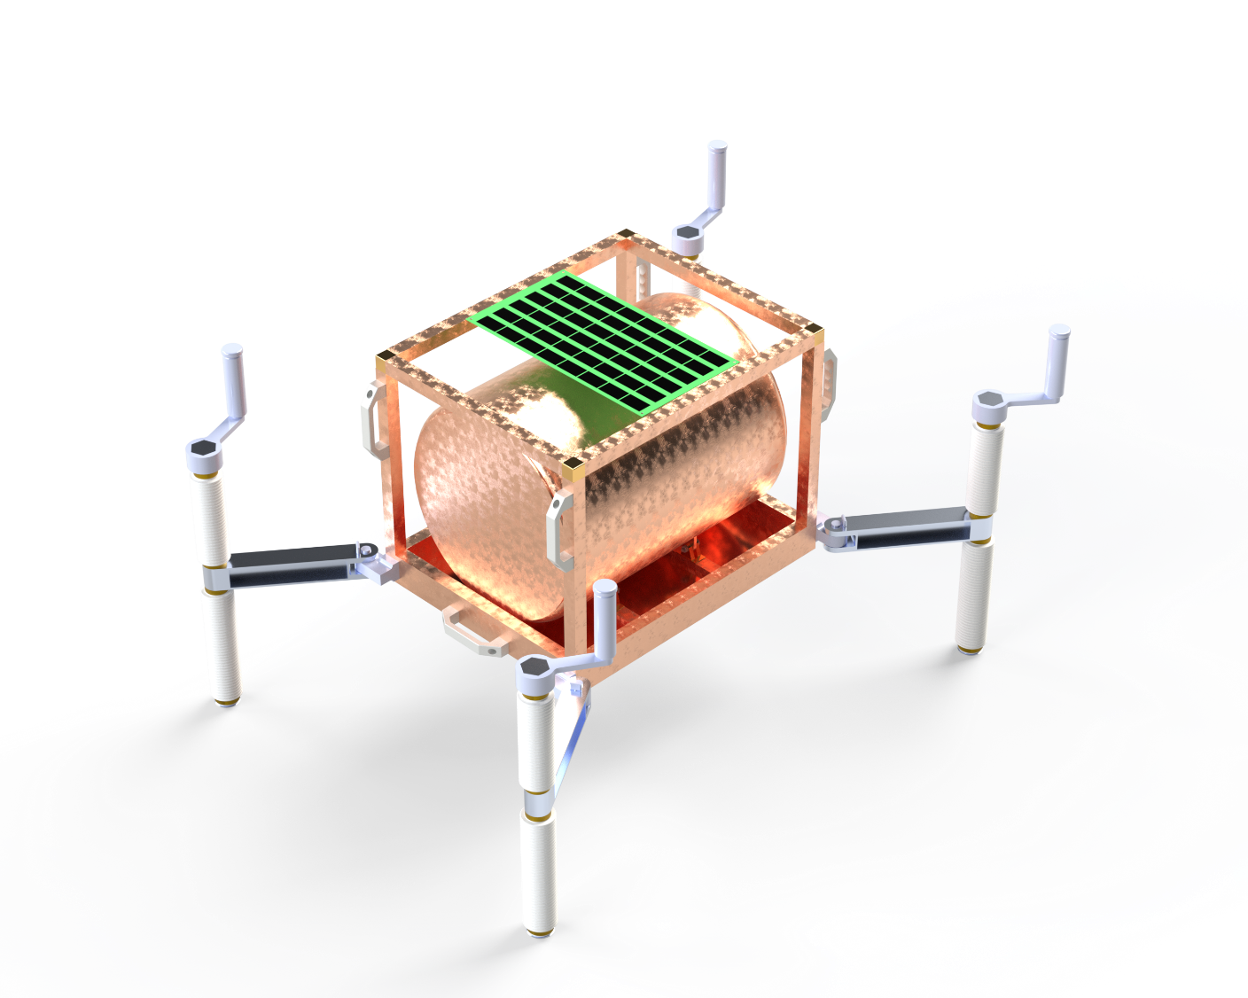


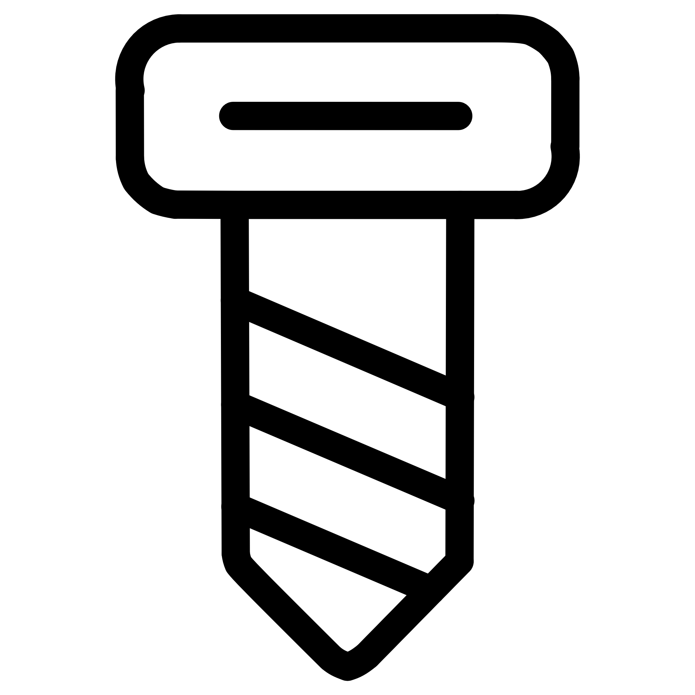


Key Components
Four-Leg System
Hinge Locking Mechanism
Lead Screw Actuation
Dust Protection
Ground Adaptation
Notes:
Swing-out I-beams increase stability footprint, similar to heavy truck outriggers.
Hinges lock using pins to prevent unnecessary movement of I-beams once deployed
TR32x10 trapezoidal screws enable independent height control for each leg through rotary input.
Stationary covers with insert bearings protect mechanisms from abrasive lunar regolith.
Ball-and-socket joints accommodate surface irregularities up to ±15°.

Slide 8
Design Assumptions & Simplifications
Rigid Ground Assumption
Rigid Ground Assumption
Load Distribution
Load Distribution
Soil bearing analysis assumes a perfectly rigid lunar surface, simplifying interaction models.
Center of gravity is assumed to be within 20% of its geometrical center.
Static Loading Conditions
Static Loading Conditions
Lead Screw Alignment
Design accounts only for steady-state loads, excluding dynamic impacts or vibrations during operation.
Preliminary calculations indicate that slight misalignment of the lead screw will not cause binding. Following calculations are done assuming this finding.
These assumptions are vital for simplifying complex analyses, providing a foundational basis for initial design validation.

Slide 9
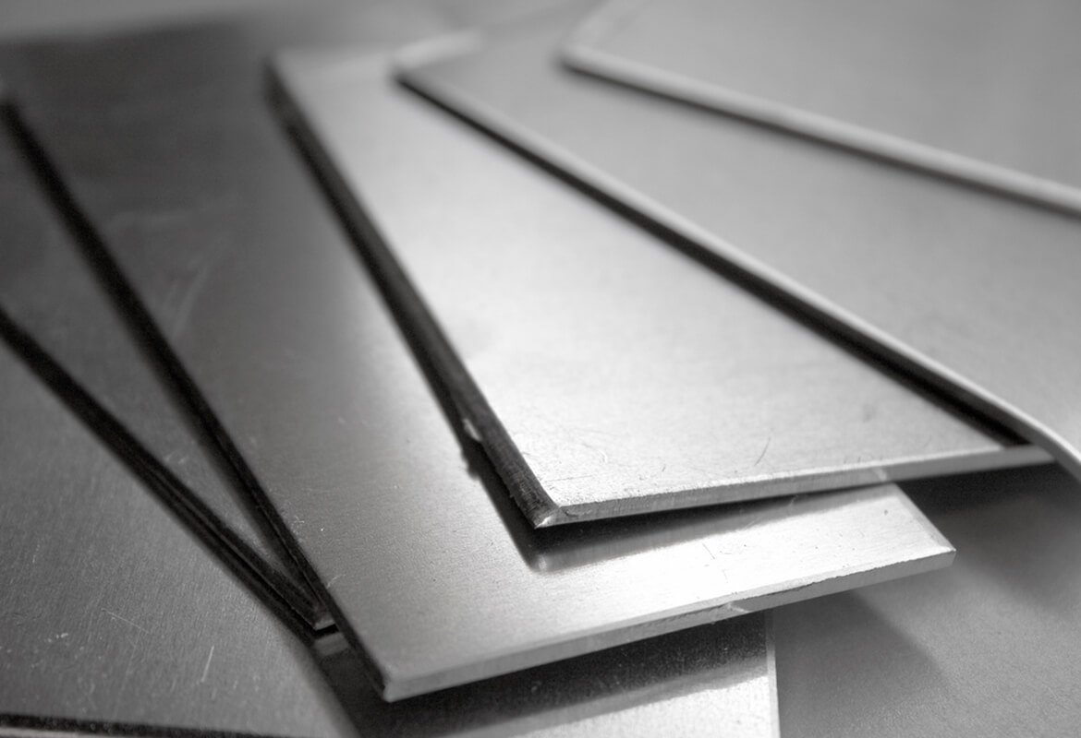
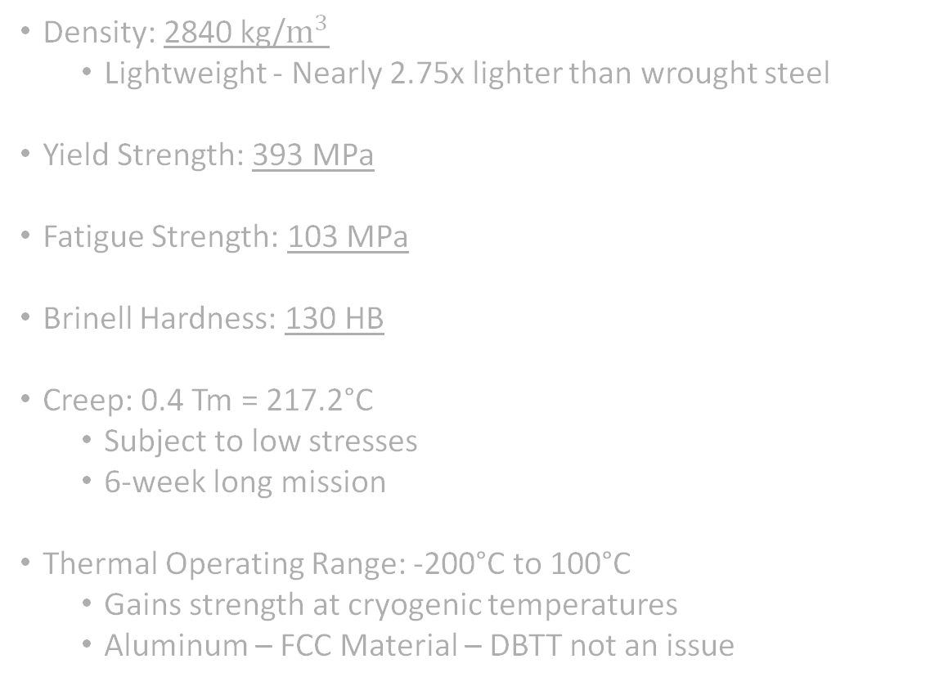
Material Selection
Aluminum 2219-T87
Density: 2840 kg/$m^{3}$
Lightweight - Nearly 2.75x lighter than wrought steel
Yield Strength: 393 MPa
Fatigue Strength: 103 MPa
Brinell Hardness: 130 HB
Creep: 0.4 Tm = 217.2°C
Subject to low stresses
6-week long mission
Thermal Operating Range: -200°C to 100°C
Gains strength at cryogenic temperatures
Aluminum – FCC Material – DBTT not an issue
Notes:
We selected Aluminum 2219-T87 for most components
primarily because it is a proven alloy with extensive aerospace heritage.
It offers a balance of
lightweight properties,
high strength,
thermal stability,
machinability.
Regarding mass, it has a density of 2,840 kg/m³,
which is nearly 3 times lighter than wrought steel,
saving critical launch mass.
Despite being lightweight,
the T87 temper provides a yield strength of 393 MPa,
giving us an incredible strength-to-weight ratio.
We noted that the fatigue strength is lower at 103 MPa, but this is not a risk for our application.
The system operates intermittently over a short 6-week mission, once
meaning it will never experience enough cycles to reach fatigue failure.
However, the Brinell hardness of 130 provides excellent surface wear resistance for the interfacing parts.
We also validated that Creep is negligible.
Creep typically becomes a factor at 40% of the melting temperature—around 220°C for this alloy.
Since our maximum operating temperature is only 100°C, we are well within the safety margin.
Finally, the thermal operating range.
Unlike steels that become brittle at low temperatures, aluminum alloys do not
Aluminum has a Face-Centered Cubic (FCC) structure. This means it does not have a ductile-to-brittle transition temperature.
Instead of becoming brittle, it actually gains strength at cryogenic temperatures, ensuring structural integrity during the lunar night."

Slide 10
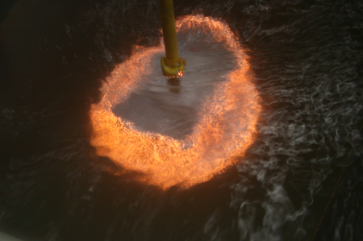
Material Selection
Keronite Coating (Plasma Electrolytic Oxidation)
Cold Welding Prevention
The ceramic oxide layer has a low adhesion surface that resists metal-to-metal bonding typically responsible for cold welding.
Coefficient of Friction 0.5-0.6
Provides self locking capability for the lead screw, enabling the system to stay raised without power input.
Hardness:3-4 times more hard than hard anodizing
Dense and crystalline structure resists abrasion, fretting, and provides wear resistance.

Slide 11
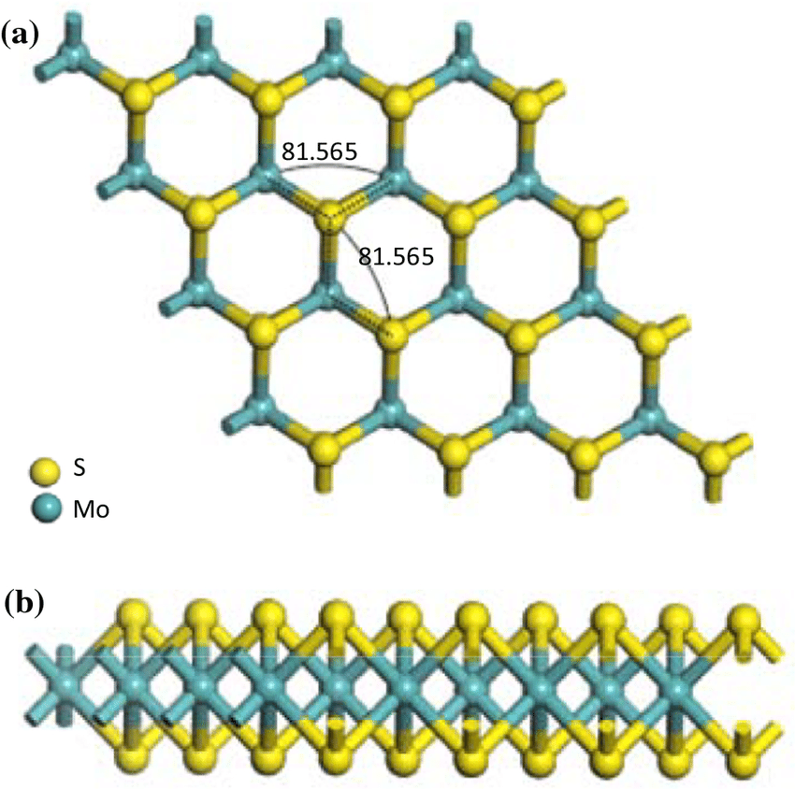
Material Selection
MoS₂ Dry Lubricant
Low Coefficient of Friction
Dynamic CoF is typically between 0.03 and 0.06.
Provides excellent lubrication without outgassing.
High Load Capacity
Has a load capacity around 1700 MPa.
Can handle high loads without wearing down.
Wide Operating Temperature Range
In vacuum environment, can operate between -200°C and +350°C, which fulfills the temperature requirement for a lunar environment.

Slide 12
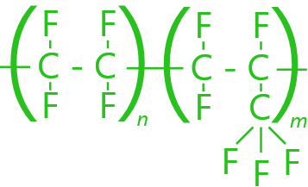
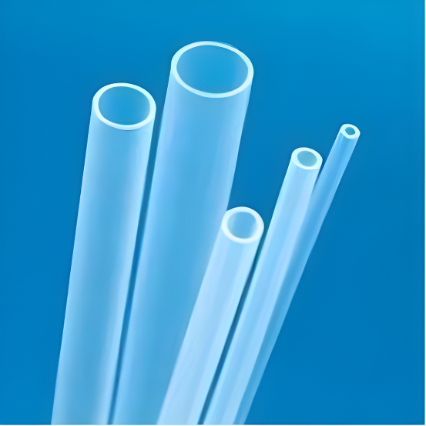
Material Selection
FEP (Fluorinated Ethylene Propylene) Fluoro-Polymer for Dust Cover
Extreme Operation Temperatures
Working temperature is between -240 to 205 C, so able to withstand required -200 to +100 C.
Good Mechanical Properties
Elastic Modulus and Yield Stress are similar to LDPE, good candidate for folding accordion style dust cover which can transmit torque.
Minimal Outgassing and Radiation Resistant
FEP meets outgassing requirements, and its transparency to UV radiation stops it from degrading in harsh radiation environments (i.e. the Moon).

Slide 13
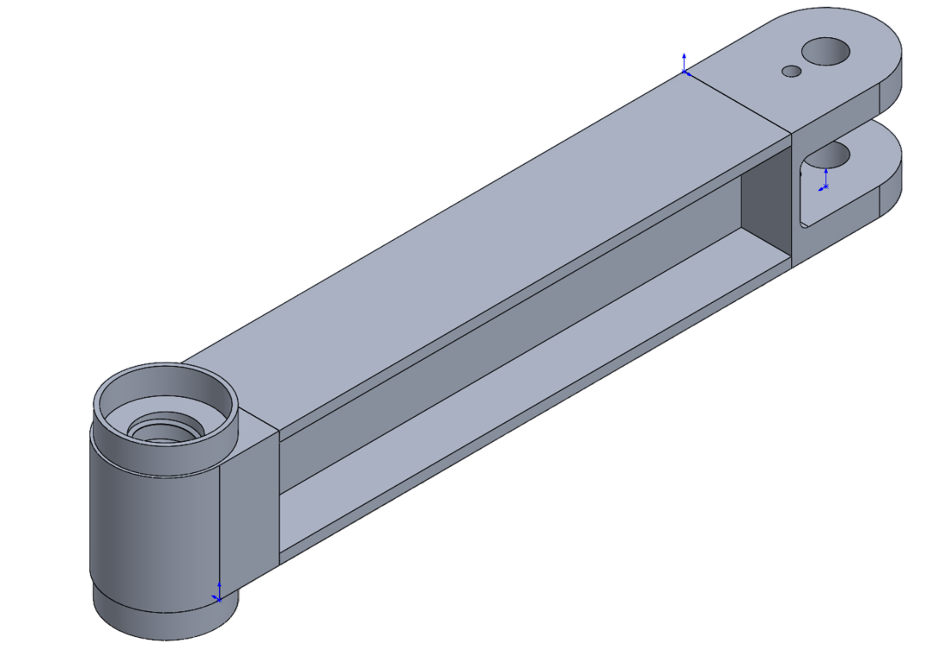
I-Beam Cross Section Analysis
Beam Type
Key Advantage
Selected
Excellent vertical bending strength, weight efficient
I-Beam
✓
Box Beam
High torsional rigidity
—
Circular Tube
Uniform stress distribution
—
Truss Beam
High stiffness-to-weight
—
I-Beam selected for superior performance in uniaxial bending loads with minimal mass—ideal for the outrigger's primary loading condition.
Experiences Bending Moment due to weight of system
Worst Case: System Mass being supported on one leg
(Peak Bending Stress: 3.64 MPa, SF = 108.5)

Slide 14

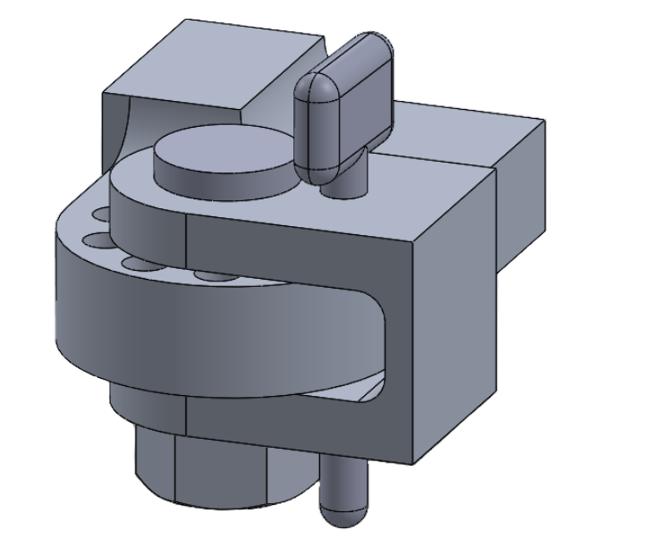
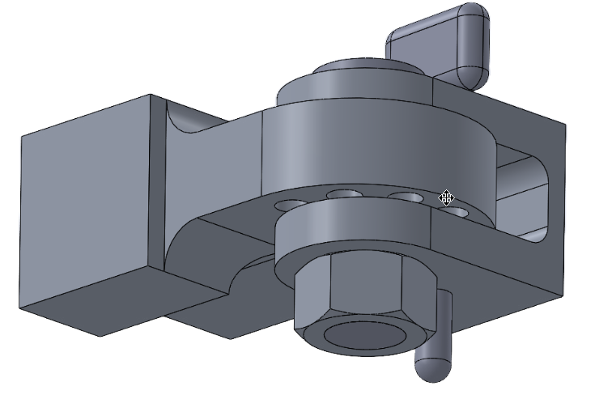
Hinge Lock Assembly
Pin-locking rotational mechanism with 20 mm diameter central shaft secured by M18 × 1.5 nut. Locking holes spaced at 37° increments enable 142° total swing, achieving required 32° deployment angle.
Robust Design
Dust Tolerance
Single-axis rotation with direct load path through solid shaft.
Sufficient clearance at non-loadbearing interfaces prevents regolith jamming.
Discrete Locking
Repeatable positions that don't degrade under wear; pin carries no axial load.
Experiences Bending Moment due to weight of system
Worst Case: System Mass being supported on one leg
(Peak Bending Stress: 3.64 MPa, SF = 2.73)

Slide 15
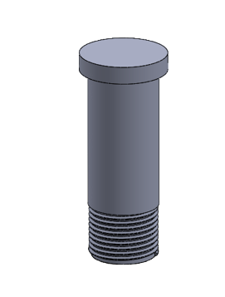
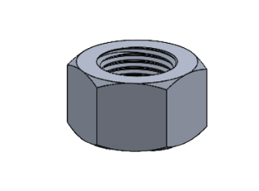
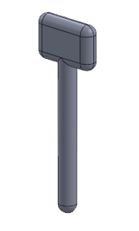
Hinge Pin and Bolt
Main Shaft Design – 20 mm Diameter
Worst-case torsional load at joint: 190N
Resulting shear stress: 48MPa
Safety Factor (shear) = 4.1
Bearing Stress: 0.6 MPa
Safety Factor (bearing): > 1000
S
Load transfer through the hinge is structurally secure, and the shaft is not a critical or high risk component.
Locking Pin Design – 8 mm Diameter
Worst-case torsional load: 3.8 kN shear
Resulting shear stress: 75 MPa
Safety Factor (shear) = 3.3
Bearing stress : 13 MPa
Safety Factor (bearing) = 30
Pin has significant margin, even though it normally carries zero structural load.

Slide 16
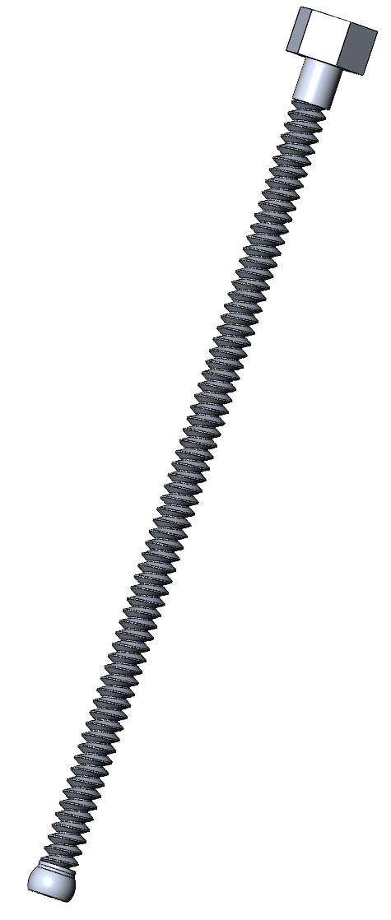
Lead Screw Specifications
TR32x10 Trapezoidal Screw
32 mm diameter, 10 mm pitch
Keronite coating friction ensure self-locking
32 mm nut prevents thread binding
Loads experienced:
Force (w/ SF) - 163.5N
Von Mises Stress – 2.4 MPa (SF = 164.6)
Critical Buckling Load – 22 kN (SF = 134.4)
Bending Stress – 281 Mpa (SF = 1.4) **Limiting Factor
Assumptions:
Worst case CG – 20% off center
Worst case rod length - 700mm
Bending treats screw as solid rod with root diameter

Slide 17
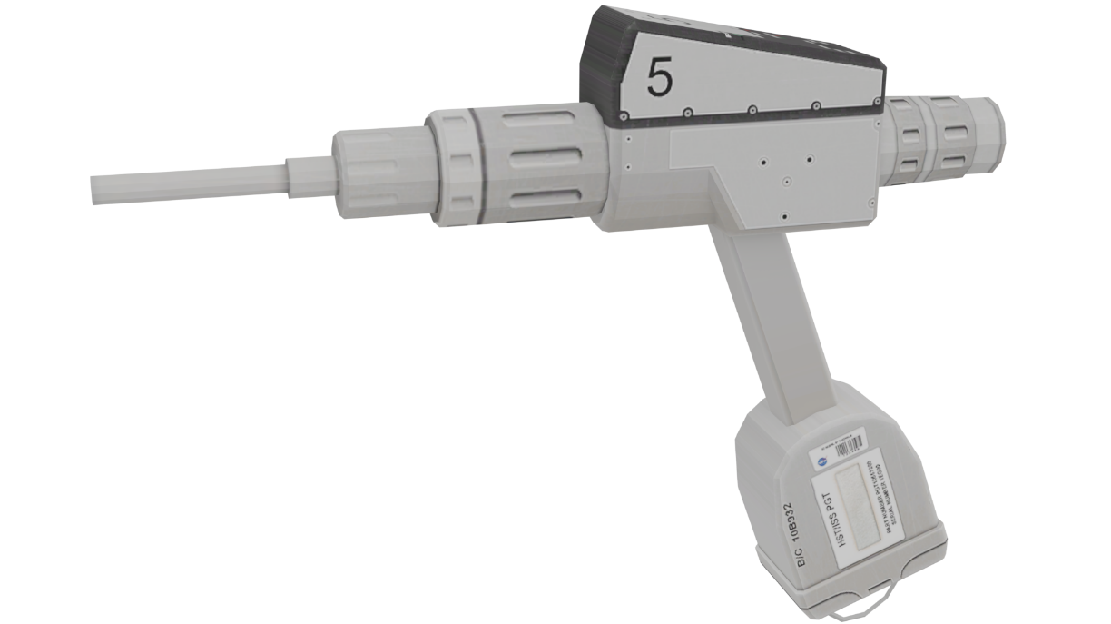
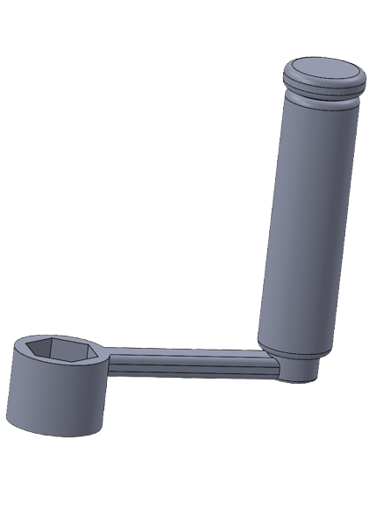

Power Requirements
Key Considerations:
Torque required: 1.5 Nm (raise), 0.8 Nm (lower).
NASA Pistol Grip Tool can be used for automated deployment
Max power: 17 Watt
Leg deployment at 18.2 mm/s
4 legs deployed in 66s
Alternative: Manual crank tool can be used.
Oversized handle for space suit use.

Slide 18
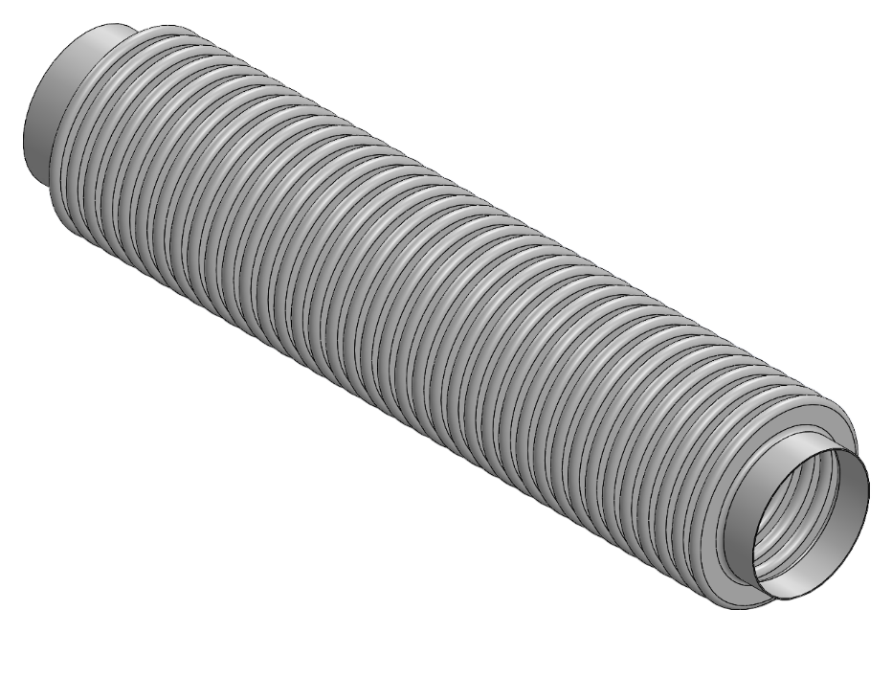

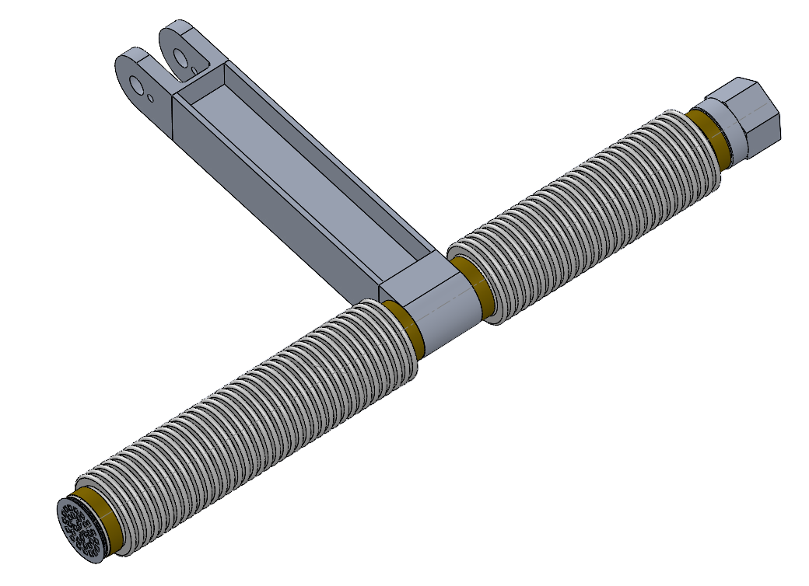

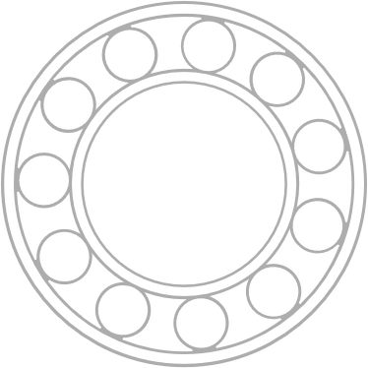

Bearing & Dust Protection
Regolith Protection
Prevents abrasive particles from contaminating threads
Decoupling Function
Allows screw rotation while holding cover stationary
Customized Insert Bearing
Press-fitted between lead screw and dust cover
Radiation & Wide Temperature Tolerance
Allows screw rotation while holding cover stationary

Slide 19
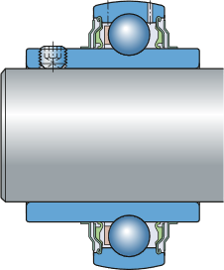
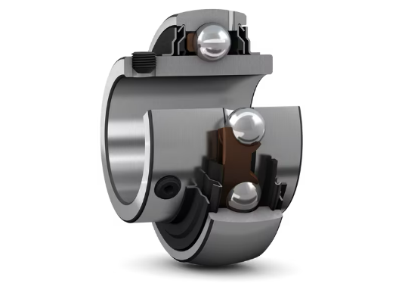
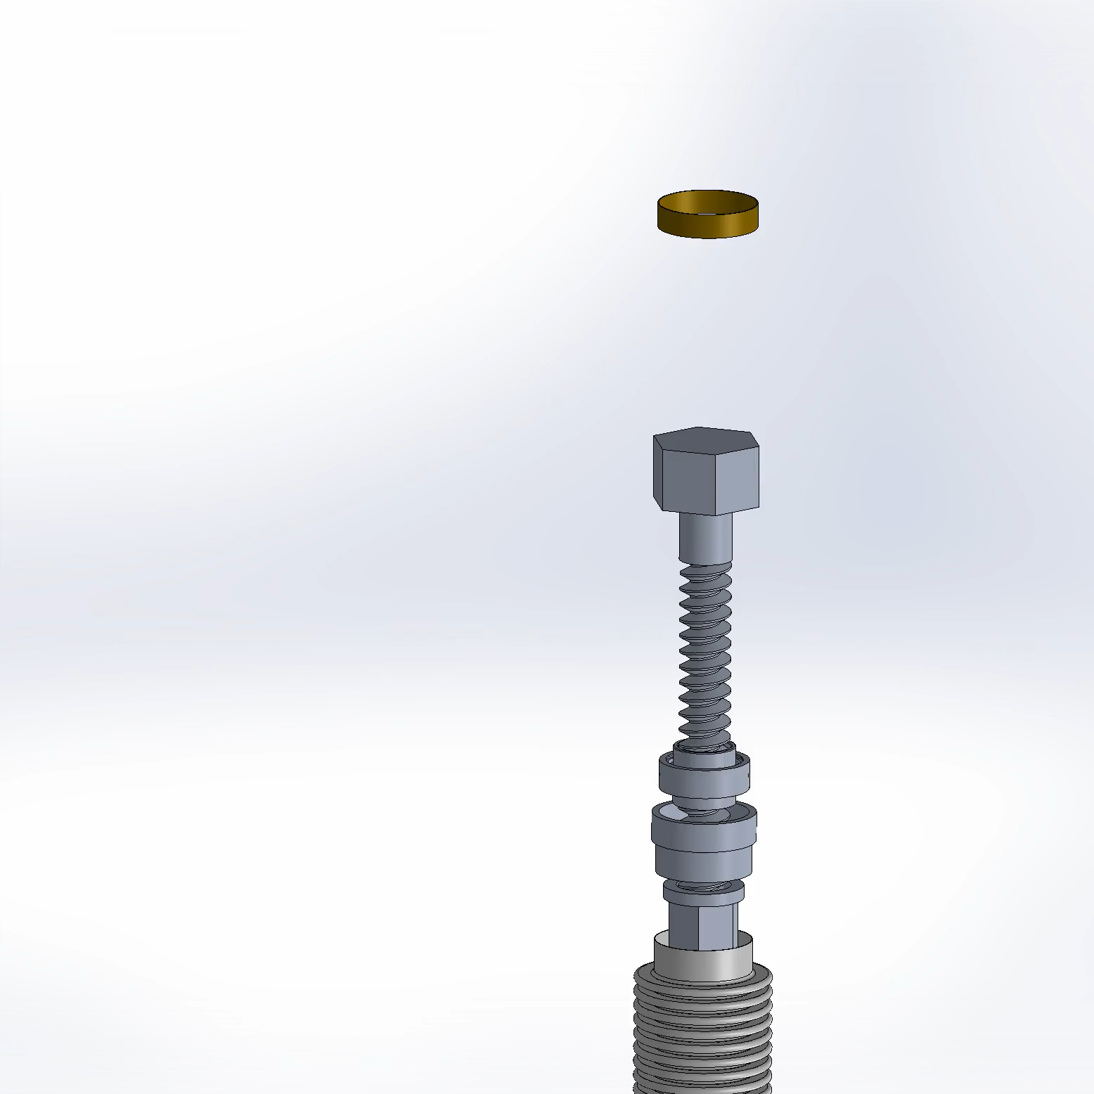
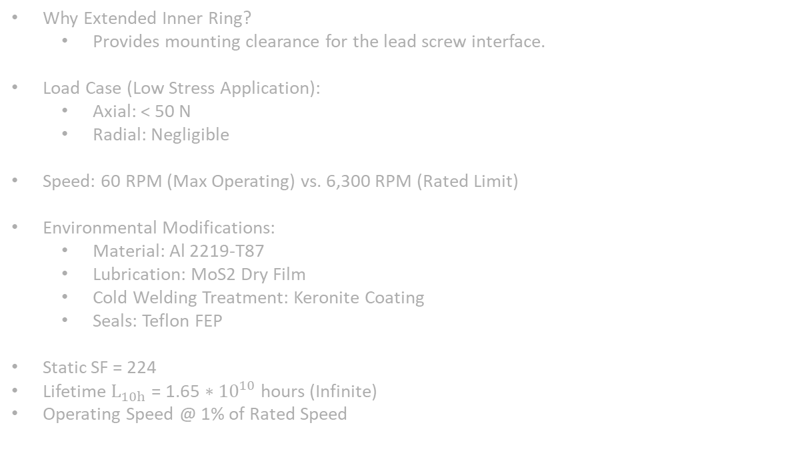
Bearing Selection:
Custom 206-Series Insert
(Baseline Geometry: SKF YAR 206-104-2F)
Why Extended Inner Ring?
Provides mounting clearance for the lead screw interface.
Load Case (Low Stress Application):
Axial: < 50 N
Radial: Negligible
Speed: 60 RPM (Max Operating) vs. 6,300 RPM (Rated Limit)
Environmental Modifications:
Material: Al 2219-T87
Lubrication: MoS2 Dry Film
Cold Welding Treatment: Keronite Coating
Seals: Teflon FEP
Static SF = 224
Lifetime $L_{10h}$ = ${\text{1.65 ∗} 10}^{10}$ hours (Infinite)
Operating Speed @ 1% of Rated Speed

Slide 20
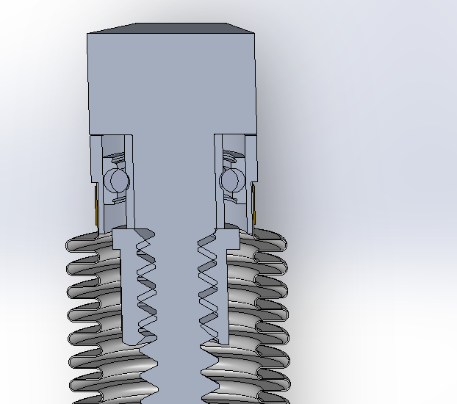
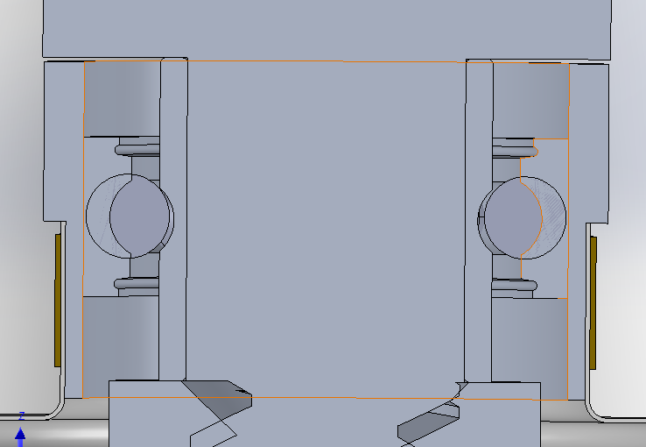

Slide 21
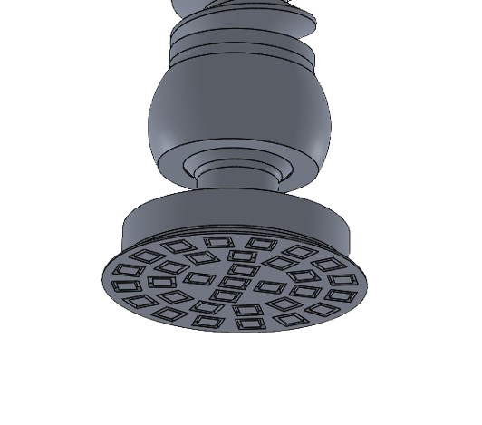
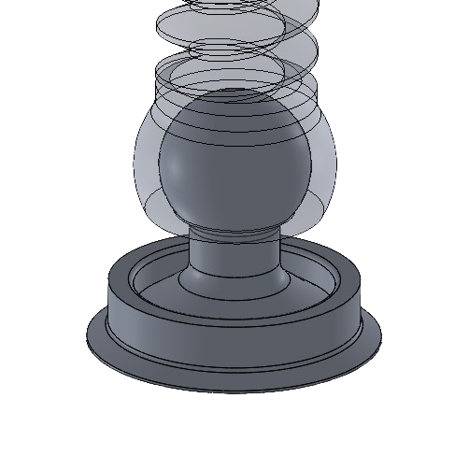
Ground Interface Design
Ball-and-Socket Joint
Inherently very robust: for Aluminum 2219-T87 joint with 30 mm ball, 23.5 socket opening diameter:
Actual Load (Worst Case): 68 N
Compressive failure load: 89 kN (SF = 1310)
Tensile failure load: 48 kN (SF = 705)
Allows 15.2° of articulation at each footpad, meeting the ±15° slope requirement.
Isolates lead screw from bending moments that could cause failure or nut interference.
Macro-texturing on footpad bottom provides traction to keep lander static

Slide 22

Final Design Features
No In-Situ Assembly
System deploys fully pre-assembled, meeting RQMT-0017 requirement.
Independent Leg Control
Each outrigger adjusts separately for precise leveling on irregular terrain.
Self-Locking Mechanism
10 mm pitch prevents unintended descent; maintains position without power.
Thermal Management
Material selection and geometry minimize thermal stress without active systems.

Slide 23
Structural Safety Factors
1.4
1.4
108
2.7
Minimum Required
Lead Screw
I-Beam Assembly
Hinge Assembly
CSA specification for all structural components
Von Misses Stress
Peak Bending Stress
Peak Bending Stress
705
224
Ball and Socket Joint
Bearings
Tensile Loading
Static Loading

Slide 24
Deployment Sequence
Stowed Configuration
Height Adjustment
System compact within 1105 × 715 mm envelope for transport.
Rotate lead screws sequentially to level platform within ±1°.
1
2
3
4
Outrigger Deployment
Final Verification
Swing beams outward to 32° angle; secure with locking pins.
Confirm 1 meter ground clearance and stable footprint achieved.

Slide 25
Further Actions
Prototyping
Soil Bearing Capacity
Fabricate functional prototype of the assembly. Conduct physical testing to validate the manual adjustment workflow, verify torque requirements, and ensure mechanism does not bind under loads.
Replace rigid ground assumption with lunar regolith soil models. Perform soil bearing analysis to verify footpad surface area prevents sinking or slippage under full load.
Dust Cover Mechanics
Sequential Adjustment
Exact mechanical properties of the dust cover are uncertain. Further analysis required to determine spring constant and torque transmission of bellows.
Astronaut must rotate around system multiple times to incrementally raise chassis. Next design iteration should implement a way to extend all four legs simultaneously.

Slide 26
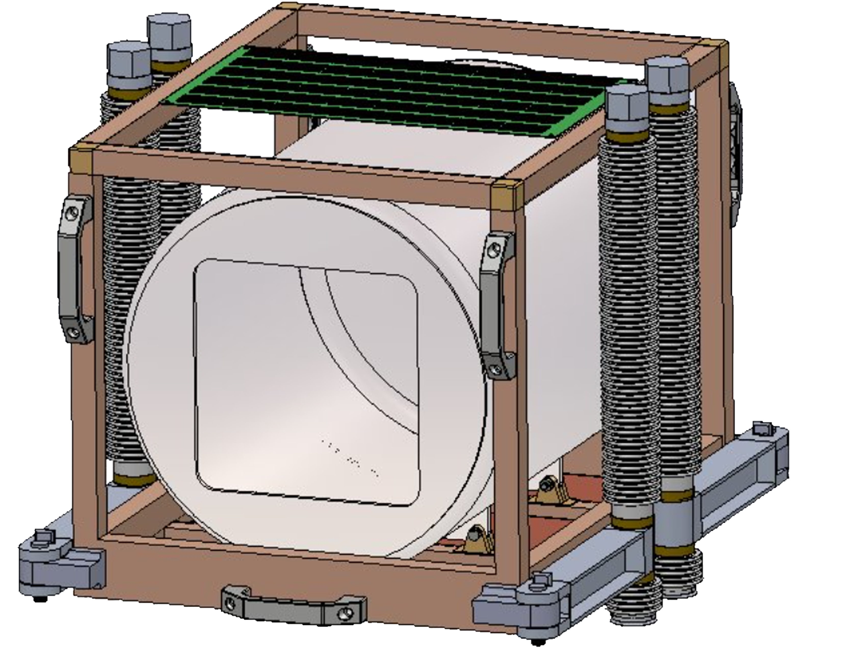
Mission Success
Requirements Met
Levels platform on ±15° slopes with ±1° accuracy
Supports 130 kg load with safety factors > 1.4
Operates in vacuum, extreme temperatures, and abrasive dust
Compact storage and manual actuation capability
The OASYS Leveling Mechanism provides a robust, lightweight foundation for lunar agriculture research, advancing the CSA's mission to enable sustainable space exploration.

Slide 27
Thank You
Q & A

Slide 28
Sources
https://www.keronite.com/surface-technology/
https://ws2coating.com/other-lubes-and-coatings/mos2-dry-film-lubricant/
https://ntrs.nasa.gov/api/citations/19960025621/downloads/19960025621.pdf
https://asm.matweb.com/search/SpecificMaterial.asp?bassnum=MA2219T87

Slide 29
Further Actions
Sequential Adjustment
Soil Bearing Capacity
Dust Cover Mechanics
Astronaut must rotate around system multiple times to incrementally raise chassis, preventing full extension of single leg to avoid dangerous tilt angles and payload shift.
Interface modeled using rigid ground assumption. Soil mechanics analysis required to validate footpad pressure against actual lunar regolith bearing capacity.
Material properties of the dust cover are uncertain. Therefore, the torque transmission capability of the dust cover not determined and requires further analysis.

Slide 30
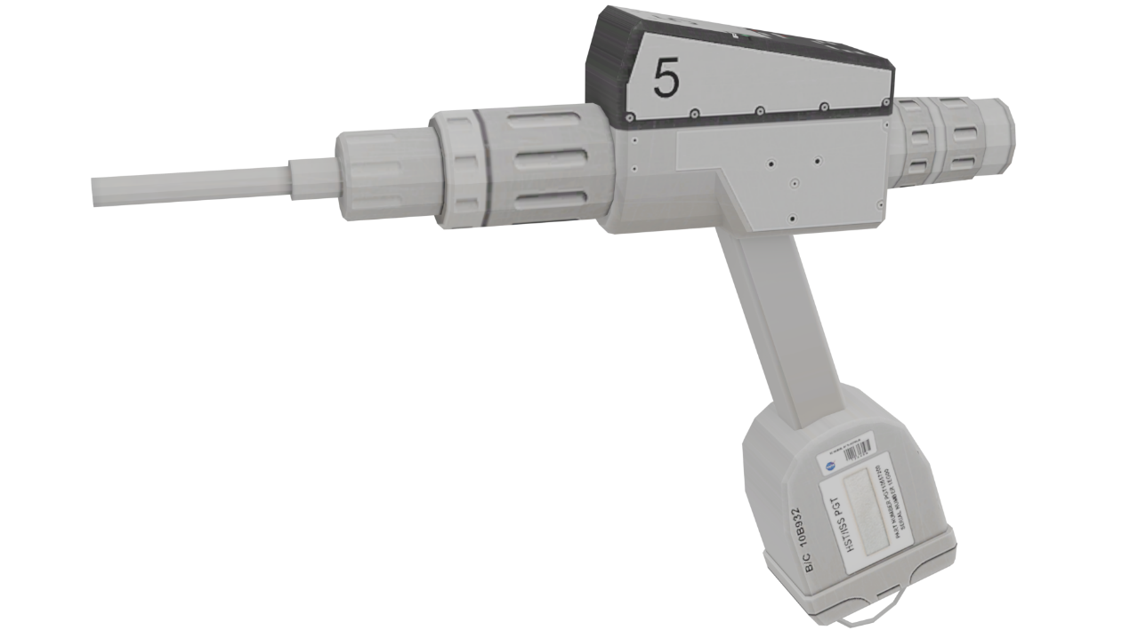
Power Requirements
Key Considerations:
Manual torque application via crank handle tool.
Torque required: 1.487 Nm (raise), 0.825 Nm (lower).
Astronaut capability: ~160N pushing force in lunar gravity.
Handle designed larger than minimum for space suit use.
Alternative: A power tool similar to
NASA's Pistol Grip Tool can be used for
deployment as well.

